Slide 1
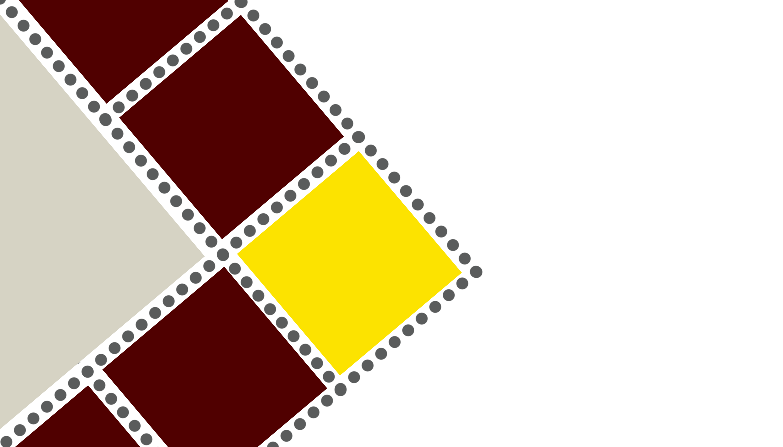
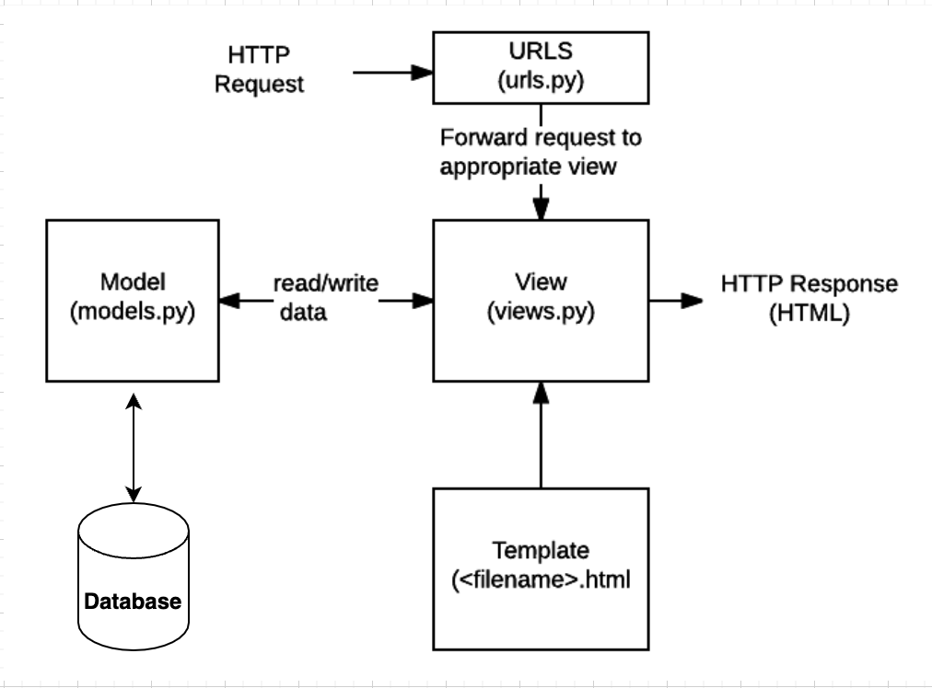

Borda Count
Team Hawk Eyes - CSCE 606 – Dr. Duncan Walker
Introduction
Design
Borda Count
This project is to build a website to implement borda count. It’s a method of aggregating individual preferences into a social preference.
An administrator creates an event, which is a choice among K objects (e.g. times for a meeting). N different users then rank the K objects, and then the website uses Borda Count algorithm to deliver the top choice. Extensions use other algorithms also, like bidding with points.
The Borda count is a family of positional voting rules which gives each candidate, for each ballot, a number of points corresponding to the number of candidates ranked lower. In the original variant, the lowest-ranked candidate gets 0 points, the next-lowest gets 1 point, etc., and the highest-ranked candidate gets n − 1 points, where n is the number of candidates. Once all votes have been counted, the option or candidate with the most points is the winner. The Borda count is intended to elect broadly acceptable options or candidates, rather than those preferred by a majority, and so is often described as a consensus-based voting system rather than a majoritarian one.
Implementation
Conclusion
All uses cases of client were successfully met. User Interface is built with responsiveness and is compatible with web and mobile devices. Standard Practices of SDLC were followed. The web application is deployed on Heroku. Client has validated the working of the Borda Count Application. List of Enhancements were discussed with Client leaving a scope for improvements on this Project.
The aggregation algorithm is integrated with a web application developed using Python Django framework with MVT architecture and SQLite database.
The admin of application can create polls and give access to specific set of users. A deadline can also be set for the poll. The admin can always view the result of the the poll at any point of time using an admin dashboard.
The users can view a list of polls shared with them. They can see the poll till the deadline is unmet. And once the user submits the poll, the submission will be recorded, and the user is marked for the submission.
Retrospective
.
What went well:
Customer Interaction
Team Collaboration
Communication between team members
Client Demo
Iterative development of product
Challenges:
Implementation of drag and drop on UI

